Slide 1
Shell Scripting
Week 2 Lecture 2.2

Slide 2
Grep examples

Slide 3
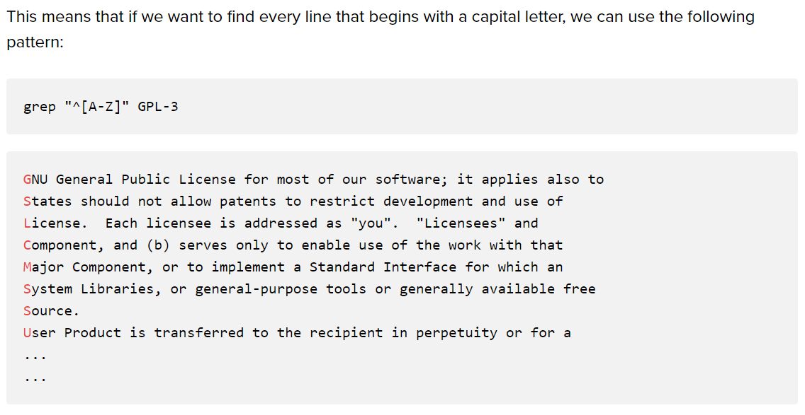

Slide 4
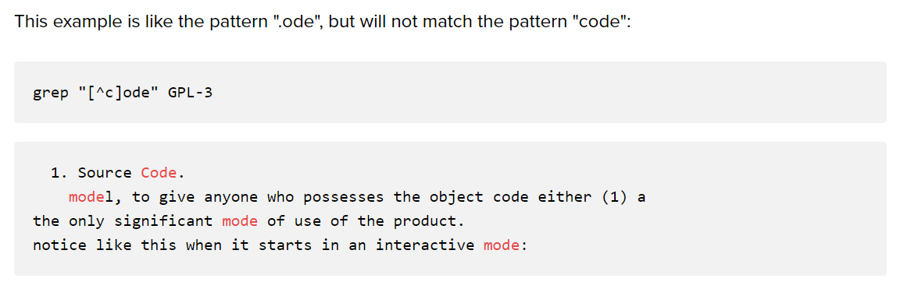

Slide 5
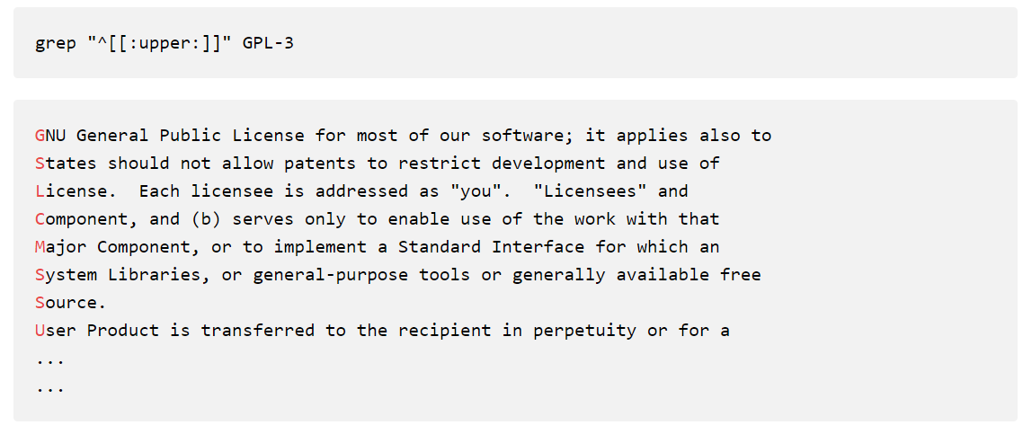

Slide 6
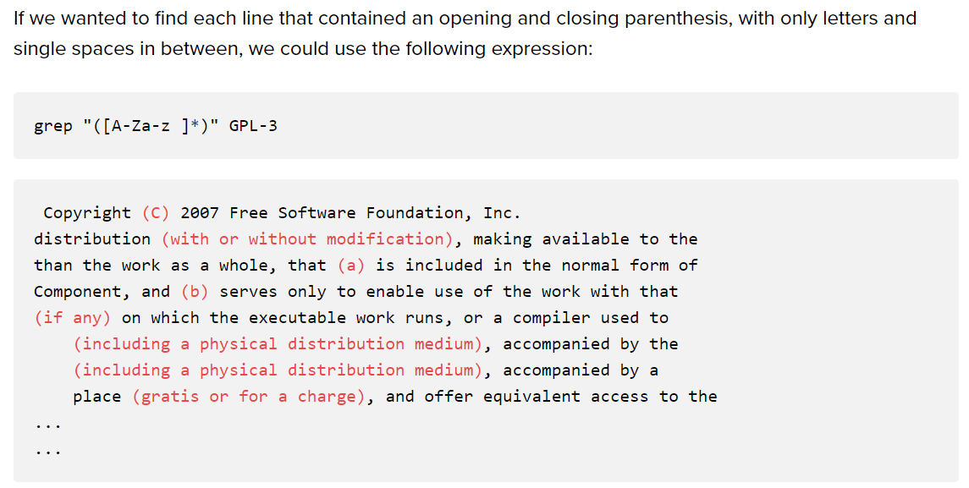

Slide 7
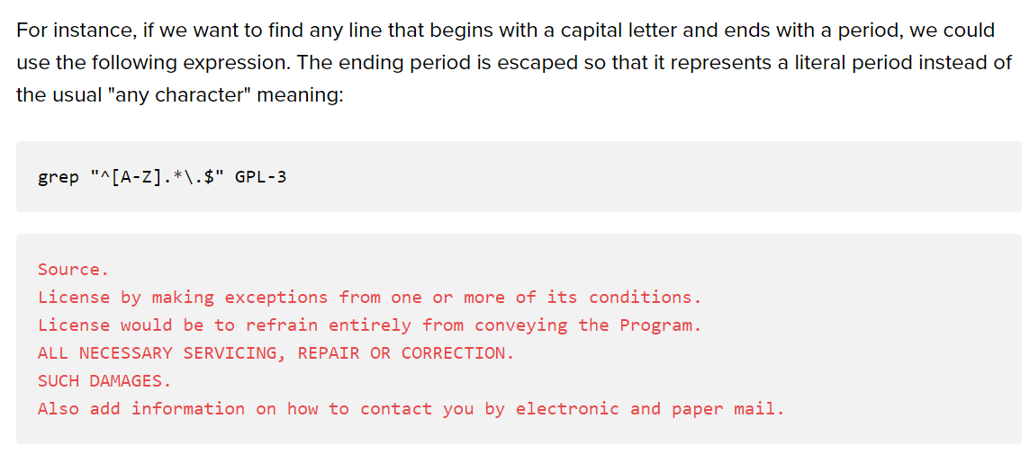

Slide 8
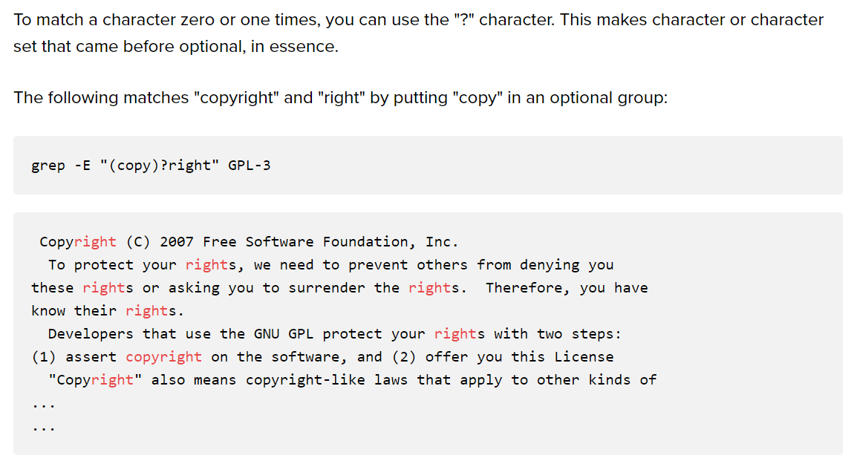

Slide 9
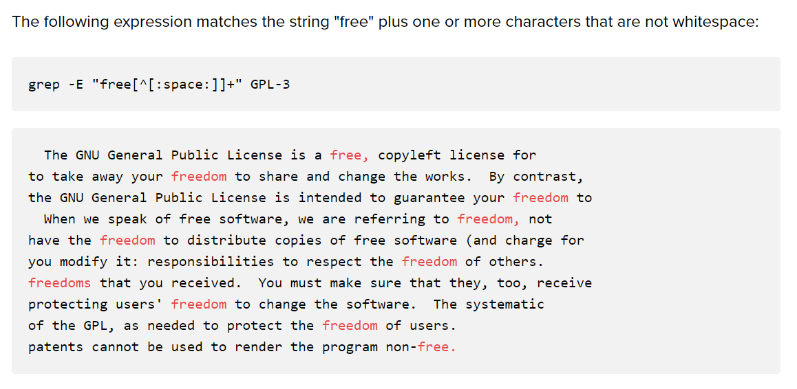

Slide 10
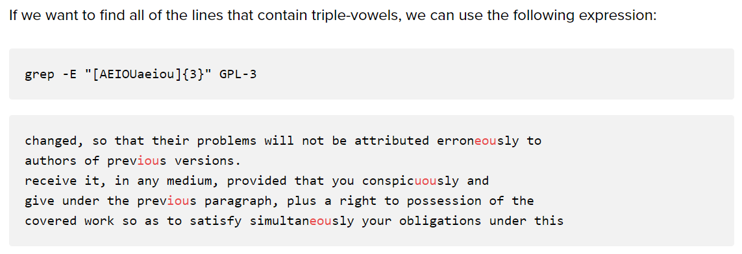

Slide 11
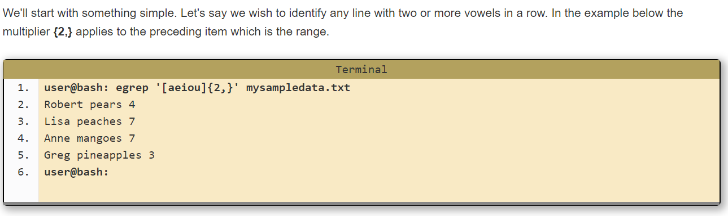

Slide 12
Output?
File names.txt
Fred apples 20 Anne mangoes 7 Greg pineapples 3 Betty limes 14 Zeesha bananas 22 Sarah cherries 1
egrep '^[^A-K]' names.txt
  Ans: Lines starting with anything except uppercase A-K
egrep '^[A-K]' names.txt
  Ans: Lines starting with uppercase A-K

Slide 13
Task 3 and 4
Get all files using find which have a number in their names using grep
  Find . –type f | grep [0-9]
List all directories using ls
  ls -d */
Exclude all lines that begin with a-z/A-Z
  grep “________” filename
  grep “^[^a-zA-Z]” filename

Slide 14
Anchoring text matches
Pattern | Text matched (in bold) / Reason match fails
ABC | Characters 4, 5, and 6, in the middle: abcABCdefDEF
^ABC | Match is restricted to beginning of string
def | Characters 7, 8, and 9, in the middle: abcABCdefDEF
def$ | Match is restricted to end of string
[[:upper:]]\{3\} | Characters 4, 5, and 6, in the middle: abcABCdefDEF
[[:upper:]]\{3\}$ | Characters 10, 11, and 12, at the end: abcDEFdefDEF
^[[:alpha:]]\{3\} | Characters 1, 2, and 3, at the beginning: abcABCdefDEF

Slide 15
Phew!
grep –E 'l*' f?.txt : prints all lines in the text files which have ‘l’ 0 or more times (technically, print everything :P). The files considered start with ‘f’ followed by only one character/number.
grep –E ‘l.*’ f*.txt : prints all lines in the text files which have ‘l’ for sure, followed by any character 0 or more times. The files considered start with ‘f’ followed by any character/number.
grep –E ‘l+' f?.txt : prints all lines in the text files which have ‘l’ 1 or more times.
grep –E ‘l.+' f?.txt : prints all lines in the text files which have ‘l’ for sure, followed by any character 1 or more times.
grep –E ‘l?' f?.txt : prints all lines in the text files which have ‘l’ or don’t have ‘l’ (Comment: ‘?’ is like binary, something exists or does not)
grep –E ‘l.?' f?.txt : prints all lines in the text files which have ‘l’ for sure followed/not followed by any character

Slide 16
Trial (Regex vs filename globbing)
Find command does not support regex but it has its own use of ‘?’ and ‘*’
  ?: matches any single character in a filename [Note: in regex ‘.?’ this means any character appears or does not]
  *: matches one or more characters in a filename
find . -name 'f?.txt’: finds file which have this format f<char>.txt
find . -name ‘f??.txt’: finds file which have this format f<char><char>.txt

Slide 17
Example
Print the lines which have ‘line’ from text files which start with f using regex
  grep -E ‘line' `(ls | grep ‘^f’)`
  Format grep <pattern> <file>

Slide 18
Text Processing Tools
sort: sorts text
wc: outputs a one-line report of lines, words, and bytes
lpr: sends files to print queue
head: extract top of files
tail: extracts bottom of files

Slide 19
sed
Now you can extract, but what if you want to replace parts of text?
Use sed!
sed ‘s/regExpr/replText/’
Example
sed 's/:.*//' /etc/passwd
Removes everything after the first colon

Slide 20
More on Variables
Read only command
hours_per_day=24 seconds_per_hour=3600 days_per_week=7 Assign values
readonly hours_per_day seconds_per_hour days_per_week Make read-only
Export: puts variables into the environment, which is a list of name-value pairs that is available to every running program
PATH=$PATH:/usr/local/bin Update PATH
export PATH Export it
env: used to remove variables from a program’s environment or temporarily change environment variable values
unset: remove variable and functions from the current shell

Slide 21
Parameter Expansion
Process by which the shell provides the value of a variable for use in the program
reminder="Time to go to the dentist!" Save value in reminder variable
sleep 120 Wait two minutes
echo $reminder Print message

Slide 22
Pattern–matching operators
path=/home/tolstoy/mem/long.file.name
Operator | Substitution
${variable#pattern} | If the pattern matches the beginning of the variable's value, delete the shortest part that matches and return the rest.
Example: ${path#/*/} | Result: tolstoy/mem/long.file.name
${variable##pattern} | If the pattern matches the beginning of the variable's value, delete the longest part that matches and return the rest.
Example: ${path##/*/} | Result: long.file.name
${variable%pattern} | If the pattern matches the end of the variable's value, delete the shortest part that matches and return the rest.
Example: ${path%.*} | Result: /home/tolstoy/mem/long.file
${variable%%pattern} | If the pattern matches the end of the variable's value, delete the longest part that matches and return the rest.
Example: ${path%%.*} | Result: /home/tolstoy/mem/long

Slide 23
String Manipulation
${string:position}: Extracts substring from $string at $position
${string:position:length} Extracts $length characters of substring $string at $position
${#string}: Returns the length of $string

Slide 24
Exit: Return value
Value | Meaning
0 | Command exited successfully.
> 0 | Failure during redirection or word expansion (tilde, variable, command, and arithmetic expansions, as well as word splitting).
1-125 | Command exited unsuccessfully. The meanings of particular exit values are defined by each individual command.
126 | Command found, but file was not executable.
127 | Command not found.
> 128 | Command died due to receiving a signal.

Slide 25
Shell Script – Using Arguments
#!/bin/bash # example of using arguments to a script echo "My first name is $1" echo "My surname is $2" echo "Total number of arguments is $#" Save as name.sh Output: $ chmod +777 name.sh $ ./name.sh Hans-Wolfgang Loidl #to execute the file My first name is Hans-Wolfgang My surname is Loidl Total number of arguments is 2

Slide 26
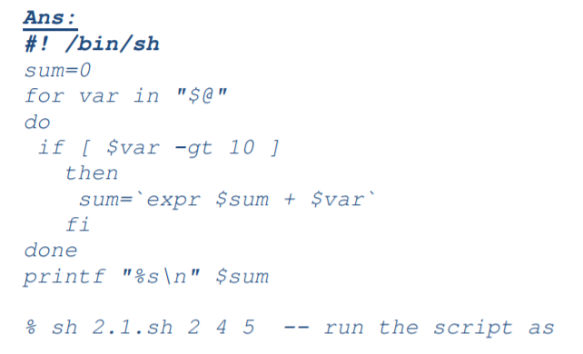
Task 5
Write a shell script sum.sh that takes an unspecified number of command line arguments (up to 9) of ints and finds their sum. Modify the code to add a number to the sum only if the number is greater than 10

Slide 27
Task 6
Write a shell script takes the name a path (eg: /afs/andrew/course/15/123/handin), and counts all the sub directories (recursively)
#!/bin/bash
ls –lR $1| grep ^d | wc -l
bash file.sh /afs/andrew/course/15/123/handin

